Slide 1

Property, Plant & Equipment Part 2 – In-Class

Slide 2
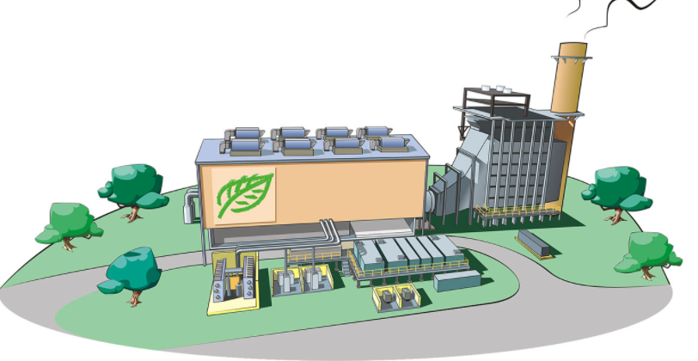
Today’s Plan
Depreciation with New Information
Asset Sales / Retirement
Non-Monetary Exchanges
Changes in Market Value (Impairments)

Slide 3
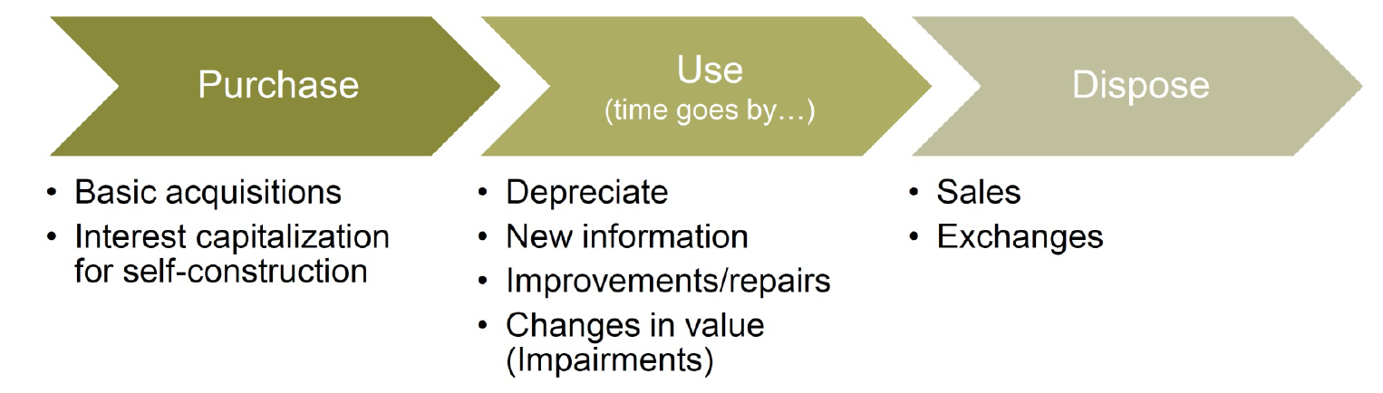
PP&E Life Cycle

Slide 4
New Information
Changes in estimates or assumptions

Slide 5
Impact of New Information
Depreciation allocates costs based on estimates made at acquisition.
New information may arise over the life of the asset:
Change in the expected life or salvage value
Change in the market value
Additional expenditures to improve the asset
The original depreciation schedule was based on estimates:
An estimate that ends up inaccurate is not an “error”
New information does not require restating prior results
Correct prospectively:
Update future depreciation schedule with the new information
It is as if the firm acquired a brand-new asset at the change
Notes:
Remember: inputs to depreciation are all estimates (useful life, salvage value, market value, improvements).
New information can arise along the way
-use machine differently than expected
-machine wears better/worse than anticipated
-add new functionality or extend life with expenditures

Slide 6

Jeremiah’s Couch
Original cost: $1,000
Useful life: 8 years
Salvage value: $200
Straight-line depreciation:
(1000-200) / 8 = $100 per year
Year 1
Year 2
Year 3
Year 4
Year 5
Year 6
Year 7
Year 8
Income Statement:
Depreciation Expense
$100
$100
Balance Sheet:
Historical cost
$
1,000
$1,000
Accumulated
Dep’n
$
(100)
($200)
Book Value
$900
$800
Notes:
Original: (10000-2000)/10=800/year
Update Yr 2 (dog not as easily trained, ella walking):
Change #1: life reduced to 6 yrs (5 remaining)
Change #2: salvage value=0
[(10000-800)-0]/5 left=1840/yr

Slide 7
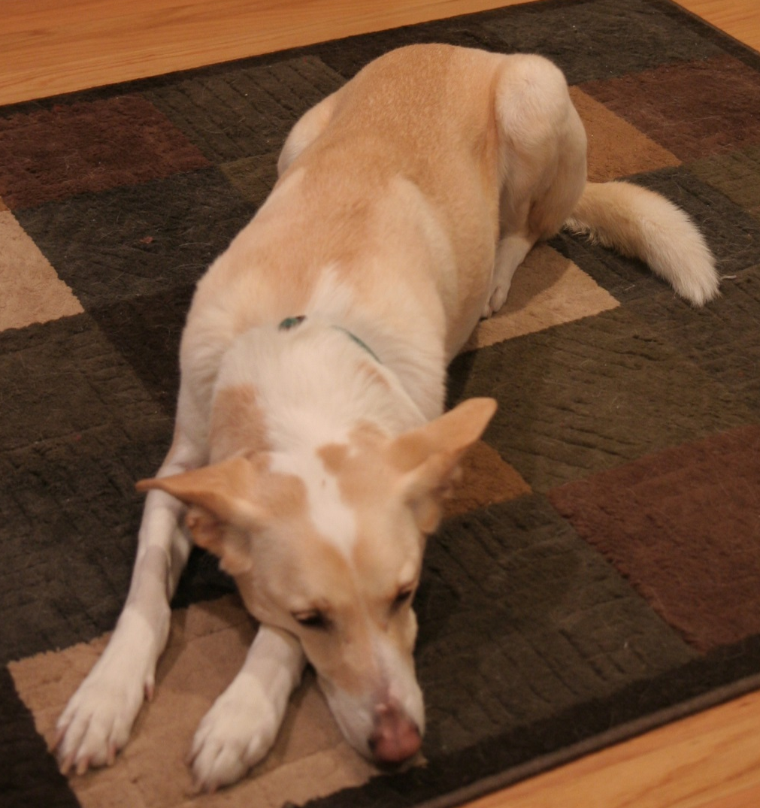

Jeremiah’s Couch
Original cost: $1,000
Useful life: 8 years
Salvage value: $200
Straight-line depreciation:
(1000-200) / 8 = $100 per year
+
2 years left
$100
(800-100) / 2 = $350 per year
Year 1
Year 2
Year 3
Year 4
Year 5
Year 6
Year 7
Year 8
Income Statement:
Depreciation Expense
$100
$100
$350
$350
Balance Sheet:
Historical cost
$
1,000
$1,000
$1,000
$1,000
Accumulated
Dep’n
($
100)
($200)
($550)
($900)
Book Value
$900
$800
$450
$100
Notes:
Original: (10000-2000)/10=800/year
Update Yr 2 (dog not as easily trained, ella walking):
Change #1: life reduced to 6 yrs (5 remaining)
Change #2: salvage value=0
[(10000-800)-0]/5 left=1840/yr

Slide 8
In-class problem: New Information

Slide 9
PP&E Life Cycle

Slide 10
Asset Retirement

Slide 11
Assets Retirements
When a long-term tangible asset is disposed, the financial statements need to reflect this event
Remove asset (original cost and accumulated depreciation)
Record consideration received (if any)
Record a gain or loss if consideration received ≠ book value
Gain if proceeds > Book Value
Loss if proceeds < Book Value

Slide 12
Assets Retirements
Standard sale: Regular Co. sells a machine that cost $100,000 and has $20,000 of accumulated depreciation for $70,000 in cash.
Cash (B-A) 70,000 (consideration received)
Accumulated Depreciation (B-XA) 20,000 (remove in full)
Asset (B-A) 100,000 (remove in full)
Cash = 70,000
-NBV = 80,000
Loss = (10,000)

Slide 13
Assets Retirements
Standard sale: Regular Co. sells a machine that cost $100,000 and has $20,000 of accumulated depreciation for $70,000 in cash.
Cash (B-A) 70,000 (consideration received)
Accumulated Depreciation (B-XA) 20,000 (remove in full)
Loss (I-X) 10,000
Asset (B-A) 100,000 (remove in full)
Cash = 70,000
-NBV = 80,000
Loss = (10,000)

Slide 14

Non-Monetary Exchanges

Slide 15
The problem…
Setting: Digger Corp. is going to miss its earnings target by just a little bit and is looking for additional ways to increase net income.
Potential Solution: Digger Corp. has a truck for operations
Net book value = $10,000 (historic cost $40,000 less accumulated depreciation $30,000)
Fair value = $15,000
If Digger sells the truck, it will recognize a $5,000 gain, but then it won’t have a truck (and it needs one)…

Slide 16
The problem…
Alternative solution: Digger could trade its truck to a used car dealer for an identical truck.
Remove the old asset
Record the new asset
Record any gain or loss(?)
Key assumption: The fair value of both sides of an arms-length transaction are equal (e.g., if the FV of what we give is $15k, then the FV of what we get must be $15k). Note this includes all assets in the exchange (PP&E, cash, etc.)
New Truck (B-A) $15,000
Accum. Depreciation (B-XA) $30,000
Gain? (I-R) $5,000
Old Truck (B-A) $40,000

Slide 17
The problem…
Was there an actual economic gain in this case?
GAAP says no…the transaction lacked “commercial substance”
Commercial Substance – A transaction that has an economic purpose and changes the cash flow of the transacting company.

Slide 18
Non-monetary asset exchanges
Scenario: Acquire a new asset by exchanging an existing asset with the other firm.
Question: What is the book value for the new asset and how much gain or loss is recorded from the exchange?
It depends…
Does the transaction have commercial substance?
Did the transaction result in a theoretical gain or loss?
Was cash received in the exchange?
Did future cash flows change?
Fair value vs. book value of asset given up
Notes:
Where determining acquisition cost gets tricky is where no cash is exchanged.
With cash, we know $1 is worth $1.
How to value if non-cash?
stock exchanged for equipment => if stock is publicly traded in liquid market, this is the best fair value
Equipment for equipment => more difficult. May want to go with the newer piece.
Why do we care? Fixing abuses (e.g., fiber optic cable swaps) – Global Crossing and Qwest, early 2000s
- need meaningful business reason, can’t just create revenue
-Auditor suggested spreading out transactions by 60 days and exchanging cash, to make it look real

Slide 19
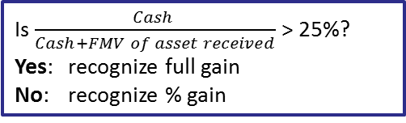
Non-monetary exchange decision tree
Does exchange have commercial substance?
yes
no
“Lacks Commercial Substance”
Recognize full gain or loss
New asset:
FMV of asset given up
+ cash paid out or
– cash received
Does exchange generate a gain?
no
yes
Recognize full loss
New asset:
FMV of asset given up
+ cash paid out or
– cash received
Does exchange involve receiving cash?
yes
no
Recognize zero gain
New asset:
FMV of asset received
– deferred gain
Recognize part or all of gain
New asset:
FMV of asset received
– deferred gain
Notes:
Recognize full gain or loss (difference between FMV of asset given minus CV)
New assets is recorded at FMV of assets given up + cash paid or – cash received. Only use the FMV of assets received if fair value of assets given is not determinable.
Deferred gain – lower depreciation expense because asset it recorded at lower value on B/S. Maybe get it back when re-selling it later.

Slide 20

Non-monetary exchange Simple Process
Know Your Journal Entries:
Always record new asset at FV (Adjust asset if lacks comm. substance & gain)
Always write off old asset (Cost and Accumulated Depreciation)
Always record cash (paid or received)
If transaction has commercial substance, record full gain or loss (use new FV)
If transaction lacks commercial substance, then record loss, or, if gain, then:
If cash received test is > 25%, recognize full gain, otherwise recognize % of gain, (New Asset is then “plugged” → Adjusted)
No gain recognized if no cash is received (Adjust Asset)
% Gain to recognize: Cash Received Test:
Notes:
Recognize full gain or loss (difference between FMV of asset given minus CV)
New assets is recorded at FMV of assets given up + cash paid or – cash received. Only use the FMV of assets received if fair value of assets given is not determinable.
Deferred gain – lower depreciation expense because asset it recorded at lower value on B/S. Maybe get it back when re-selling it later.

Slide 21
In-class problem
Rex Company exchanged equipment used in its manufacturing operations for equipment used in the operations of Slinky Inc. Rex also received $3,000 in cash consideration from Slinky. The following information pertains to the equipment given up by each company.
Prepare the journal entries to record the exchange on the books for both companies assuming the exchange has commercial substance.
Prepare the journal entries to record the exchange on the books for both companies assuming the exchange lacks commercial substance.
 | Slinky | Rex
Equipment (original cost) | $28,000 | $28,000
Acc. Depreciation | $10,000 | $19,000
Fair value of equipment | $12,500 | $15,500

Slide 22
PP&E Life Cycle

Slide 23
Change In Market Value (Impairments)

Slide 24
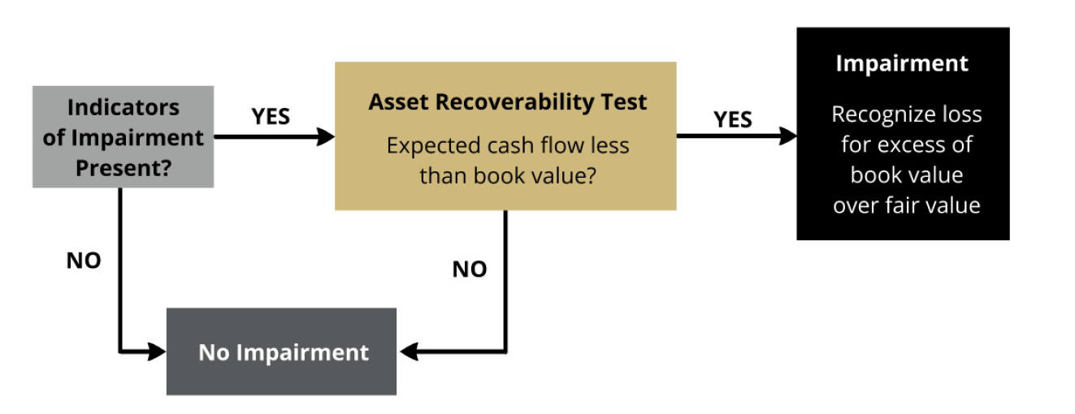
Changes in Market Value of Assets
Asset impairment occurs when future economic value of the asset (ability to generate future cash flow) decreases significantly
Test Two
Test One
Do we Test?
Notes:
Accounting is conservative:
-Don’t write up (i.e., don’t realize any holding gains until sell the asset)
-Write down (i.e., incur holding costs immediately)
Implication:
-may have some buildings/land with much greater MV than recorded.
-can’t recog gain unless sell.
-leads to some shady transactions where form=sale, substance=retained
-e.g., sale-leaseback (FASB plugged this hole: no longer a sale w/gain recog)
Undiscounted cash flows:
-includes maintenance
-assumptions about future use (e.g., “highest and best use”, firm assumptions, market assumptions

Slide 25
Impairment Example
Happy Inc. owns an Ice Cream Machine. Facts:
At 12/31/2022, cost basis is $24,000 and acc depr is $6,000
Net Book Value = 24,000 – 6,000 = $18,000
The “best” estimate of expected cash flows over the next four years (undiscounted) related to the oven are:
2023: $3,000
2024: $4,500
2025: $3,000
2026: $2,500
Total $13,000
The fair value of the Ice Cream Machine at December 31, 2022 is $10,500.
Notes:
Step 2: Lots of estimates, this is just the “best” one
Step 3: Not FV of cash flows from step 2 b/c
i. firm est of cash flows is not necessarily the same est market would make
ii. Don’t know market discount rate

Slide 26
Impairment Example
When: Assume “events and changes in circumstances” indicate possible impairment
Recoverability test:
$13,000 (Est. cash flow) < $18,000 (Net Book Value)
→ Need impairment
Write down to fair value (~ market price)
Notes on fair value:
Value the “market” would place on the asset given how market participants (not the firm) would use it.
Write-down from NBV ($18,000) to FV ($10,500)
Loss (I-E) $7,500
Accumulated Depr (B-XA) $7,500
Notes:
Remember:
− est. cash flows of $11,000 is based on firm assumptions and use.
− est. market value based on market assumptions and use

Slide 27
Property, Plant & Equipment Part 2 – In-Class

